Slide 1
Benchmarking Open-Source Property-Graph Databases with a Portable Mixed-Workload Protocol and a Live Scale-Out Event
Mustafa Can Çalışkan Istanbul Technical University BLG 564E Advanced Database Systems — Spring 2026
Notes:
Good morning everyone. My name is Mustafa Can Çalışkan. Today I will be presenting my term project. I took five open-source graph databases, ran the same tests on all of them, and then, while they were still serving queries, I added a new server to the cluster to see what happens. I will start with some background, walk you through my method, and then show the results.

Slide 2
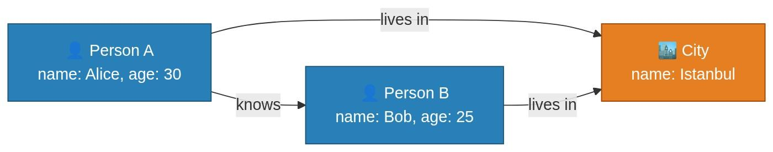
What Is a Property-Graph Database?
▸ Data stored as nodes (entities) and edges (relationships)
▸ Each node and edge can carry extra information — called properties
▸ Real-world uses: social networks, fraud detection, recommendation engines
▸ Examples: Facebook's social graph, bank transaction monitoring
Notes:
Before I get into the project, let me quickly explain what a property-graph database actually is. Most people are familiar with relational databases. You have tables, rows, columns. A graph database works differently. Instead of tables, you have nodes and edges. A node can be anything. Think of a person, a company, or a bank account. An edge is a connection between two of those things. For example, person A knows person B, or account X sent money to account Y. And both nodes and edges can carry extra information, which we call properties. So a person node might have a name, an age, a city it lives in. This structure is very natural for social networks, fraud detection, and recommendation engines. Anywhere the relationships between things matter as much as the things themselves.

Slide 3
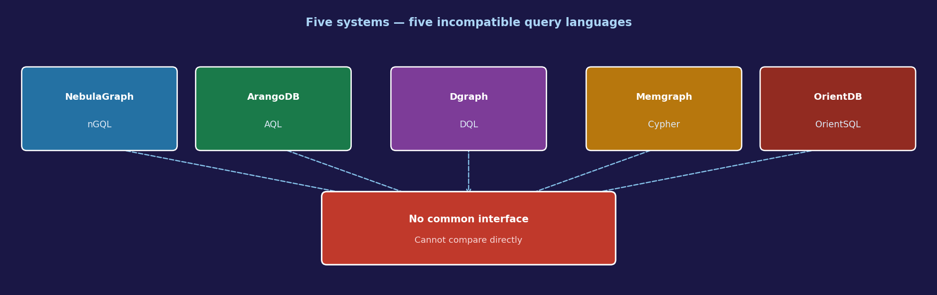
The Challenge: Why Comparing Them Is Hard
▸ Each system uses a different query language (nGQL, AQL, DQL, Cypher, OrientSQL)
▸ Each system has a different storage engine (LSM-tree, adjacency list, in-memory)
▸ Different consistency guarantees — from full ACID to eventual consistency
▸ → A query for one system cannot run on another without a full rewrite
▸ → No unified way to compare them fairly across multiple workload types
Notes:
So here is the problem. There are many graph database systems out there, but they are very different from each other. Each one has its own query language. A query I write for ArangoDB simply will not run on NebulaGraph at all. They also store data in fundamentally different ways, and they make different promises about data correctness. All of this makes fair comparison really difficult. And if you look at the existing benchmarks in the literature, each one focuses on a single workload type, and none of them test what happens during a live scale-out. That is exactly the gap I am trying to fill.

Slide 4
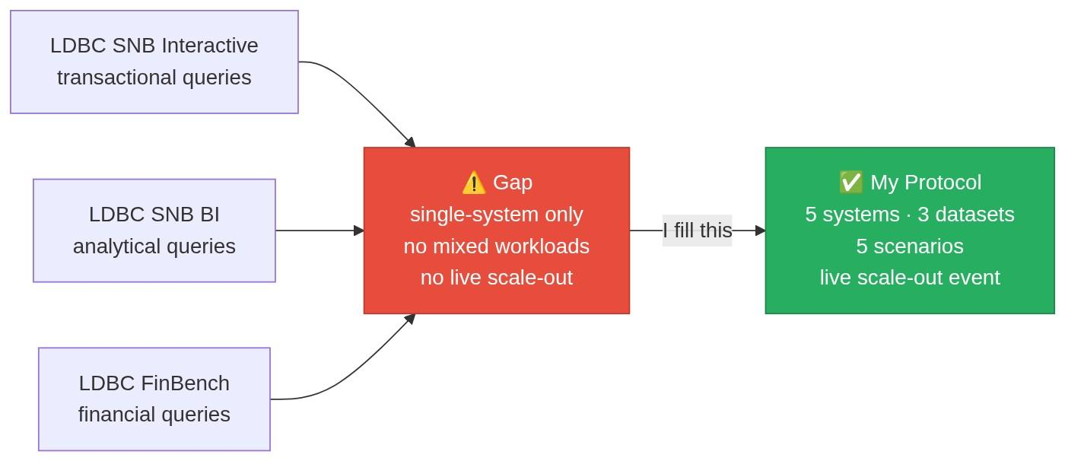
What Exists in the Literature and What Is Missing
▸ LDBC SNB Interactive v2 → standard transactional graph benchmark
▸ LDBC SNB Business Intelligence → standard analytical graph benchmark
▸ LDBC FinBench → financial transaction graph benchmark
▸ Galaxybase, ByteGraph, G-Tran → mixed workloads, but single-system only
▸ Gap: no portable multi-system benchmark with mixed workloads and live scale-out
Notes:
There is an organization called the Linked Data Benchmark Council, LDBC for short, and they produce the standard benchmarks for graph databases. SNB Interactive is for short transactional queries. SNB Business Intelligence is for heavier analytical queries. And FinBench covers financial transaction scenarios. The issue is that each of these is designed to be run on one system at a time, and each one covers only a single workload type. Some recent papers, like Galaxybase and ByteGraph, do test mixed workloads, but they only run on their own proprietary system. So nobody has combined all three LDBC suites, run them on five different systems, and added a live scale-out event. That is exactly what I do.

Slide 5
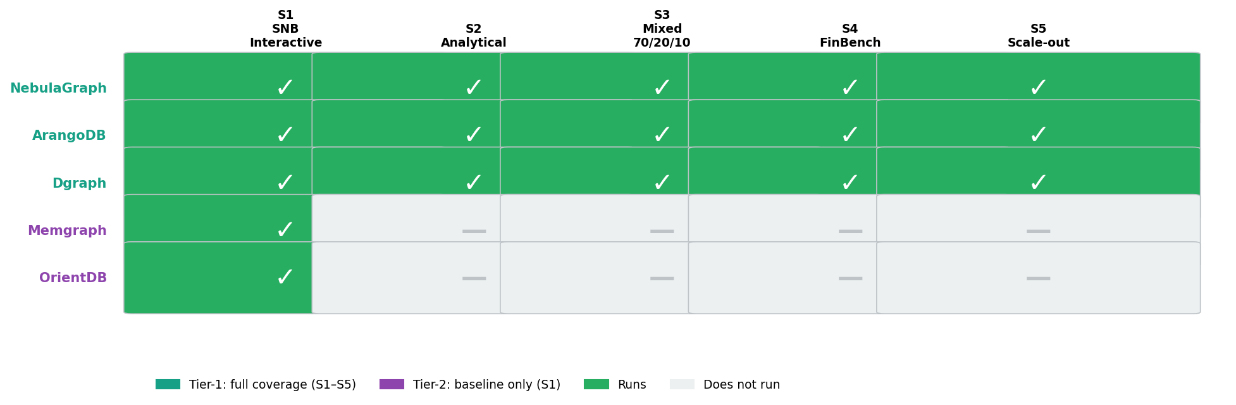
My Protocol: 5 Systems · 3 Datasets · 5 Scenarios
▸ Tier-1 (full coverage): NebulaGraph · ArangoDB · Dgraph
▸ Tier-2 (S1 baseline only): Memgraph · OrientDB
▸ 5 scenarios: S1 transactional · S2 analytical · S3 mixed · S4 FinBench · S5 live scale-out
▸ S3 mix: 70 % IS (short reads) · 20 % IC (complex reads) · 10 % IU (updates)
▸ → My contribution: first portable multi-system study combining all three LDBC datasets with a live scale-out event
Notes:
I test five graph databases organized into two tiers. Tier one, which is NebulaGraph, ArangoDB, and Dgraph, runs all five scenarios. Tier two, which is Memgraph and OrientDB, runs only S1 for a baseline comparison. I use three public LDBC datasets, which are SNB Interactive, SNB BI, and FinBench. S1 covers all fourteen SNB Interactive query types. S2 is purely analytical. S3 mixes three query types at a seventy, twenty, ten percent split. S4 uses the FinBench financial dataset. And S5 is the same as S3, but with a scale-out at ten seconds.

Slide 6
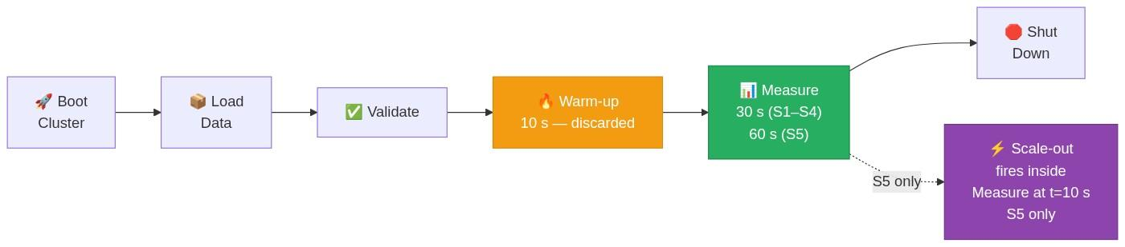
How I Run Each Test
▸ 6-step process per run: Boot → Load → Validate → Warm-up → Measure → Shut down
◦ S5 only: scale-out fires at t = 10 s inside the 60 s measurement window
▸ Closed-loop driver: 16 async workers (8 for S2) — no pause between queries
▸ Fixed random seeds → every run is 100% reproducible, byte-for-byte
▸ Per-request log: timestamp, latency, query class, status → stored in Parquet
Notes:
Every test run follows the same six steps. First I boot the cluster and load the data. Then I run a short validation with known-answer queries. After that comes a ten-second warm-up, which I throw away. Then the actual measurement, thirty seconds for most scenarios and sixty for S5. In S5 the scale-out fires at t equals ten seconds, right in the middle of that window. Finally I shut everything down. During the measurement, sixteen workers run in parallel. Each one sends the next query as soon as it gets an answer, with no waiting in between. And because every random seed is fixed, anyone can run the exact same campaign and get the exact same results.

Slide 7
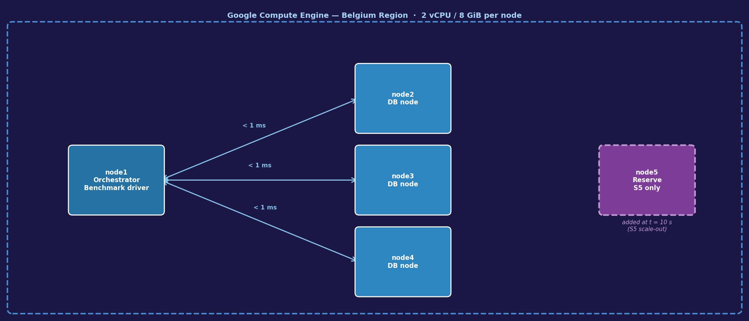
Experimental Setup
▸ 5-node GCP cluster, Belgium region — < 1 ms intra-cluster latency
▸ Each node: 2 vCPUs · 8 GiB RAM · 50 GB SSD · Ubuntu 24.04 LTS
▸ SF = 0.003 for SNB · SF = 0.01 for FinBench — minimum the generators accept
▸ At SF = 0.003: ~1,500 persons, ~150,000 posts — fits entirely in RAM
▸ 51 total runs · 444,297 requests recorded · campaign completes in < 2 hours
Notes:
I ran all experiments on Google Cloud in the Belgium region, on five virtual machines with under one millisecond of network delay between them. Each machine has two CPUs and eight gigabytes of memory. Node one runs my benchmark code, nodes two through four host the database, and node five sits idle until the scale-out test. For the dataset, I used the smallest scale factor each generator accepts, which is zero point zero zero three for SNB and zero point zero one for FinBench. Both datasets fit entirely in RAM, so disk speed is not a factor here at all. In total I ran fifty-one experiments and recorded nearly four hundred forty-four thousand requests, and the whole campaign finished in under two hours.

Slide 8
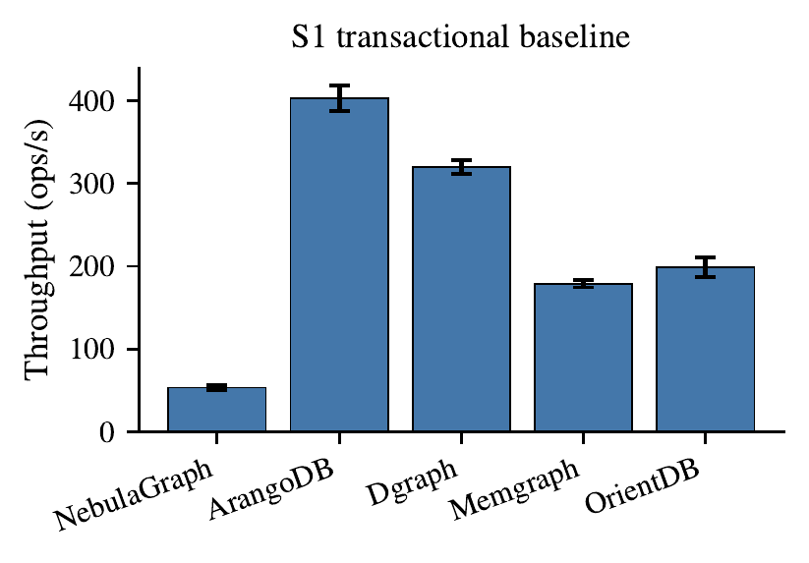
Result 1: Who Is Fastest? — S1 Throughput
▸ ArangoDB 403 ops/s · Dgraph 320 · OrientDB 199 · Memgraph 179 · NebulaGraph 53
▸ ArangoDB is 7.6× faster than NebulaGraph — Tier-1 rankings confirmed (Welch t-test, p < 0.01)
▸ OrientDB vs. Memgraph gap: directional only — not statistically confirmed at 3 repetitions
Notes:
This bar chart shows how many queries each system completes per second in S1. Higher is better. ArangoDB is the fastest at four hundred three. Dgraph is second at three hundred twenty. OrientDB and Memgraph are in the middle. NebulaGraph is the slowest at fifty-three. So ArangoDB is about seven point six times faster than NebulaGraph. I ran a Welch t-test to check if these gaps are real. For ArangoDB versus Dgraph the t value is eight point two, which is well above the threshold, so that ranking is statistically confirmed. The gap between OrientDB and Memgraph is only twenty operations per second, and with three repetitions that is not enough to call it statistically significant.

Slide 9
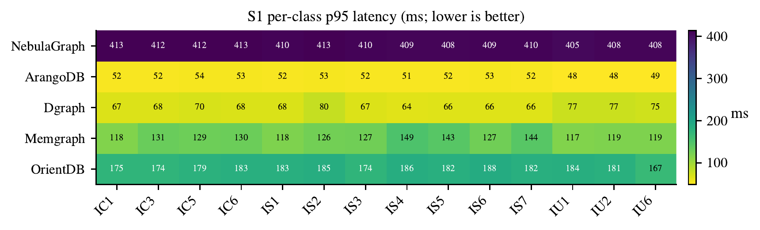
Result 2: Per-Query-Class Latency — S1 Heatmap
▸ 14 query classes × 5 systems — p95 latency in ms, lower = better
▸ Every system shows uniform color across all 14 columns — no class-specific strength or weakness
▸ → Performance gap is systemic (architecture-driven), not query-specific
Notes:
This heatmap shows p-ninety-five latency for each of the fourteen query types in S1. Each row is a system, each column is a query type. Lighter means faster. You can see every system has almost the same color across all fourteen columns. ArangoDB is light everywhere. NebulaGraph is dark everywhere. No system is especially good or bad at any particular query type. This tells us the performance gap is not caused by the query type. It is caused by how the system is built internally. The ratio stays the same across all classes.

Slide 10
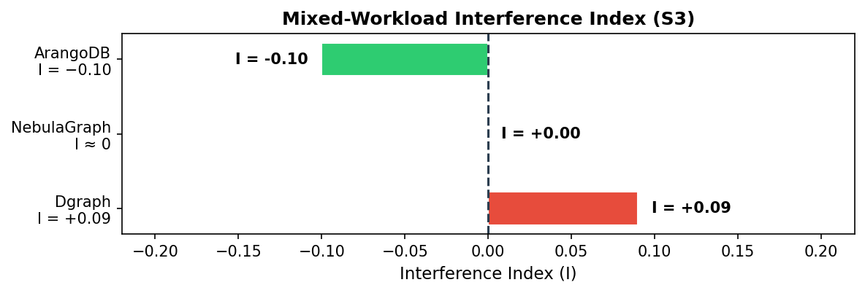
Result 3: Mixed Workloads (S3) and FinBench (S4)
▸ Interference index I: measures if mixing hurts (I > 0) or helps (I < 0)
▸ ArangoDB I = −0.10 → cache sharing makes the mix ~10% faster
▸ NebulaGraph I ≈ 0 · Dgraph I = +0.09 → complex reads (IC) contend with short reads (IS)
▸ S4 (FinBench): all Tier-1 systems faster than S1 — simpler single-hop lookups
Notes:
In S3 I mix seventy percent short reads, twenty percent complex reads, and ten percent updates simultaneously. I compute an interference index to measure if mixing hurts or helps. Zero means no effect. Positive means slower than expected. Negative means faster. ArangoDB gets minus zero point one zero. The mix is about ten percent faster because the short reads and complex reads both access the same person and forum data, so ArangoDB ends up reusing cached pages. NebulaGraph is basically zero. It was already at its speed limit, so mixing made no difference. Dgraph is plus zero point zero nine. The complex reads and short reads compete on the same read path, which caused a nine percent slowdown. For S4, all three Tier-1 systems are faster than S1 because FinBench queries are mostly simple one-hop lookups, which are much faster than SNB complex reads.

Slide 11
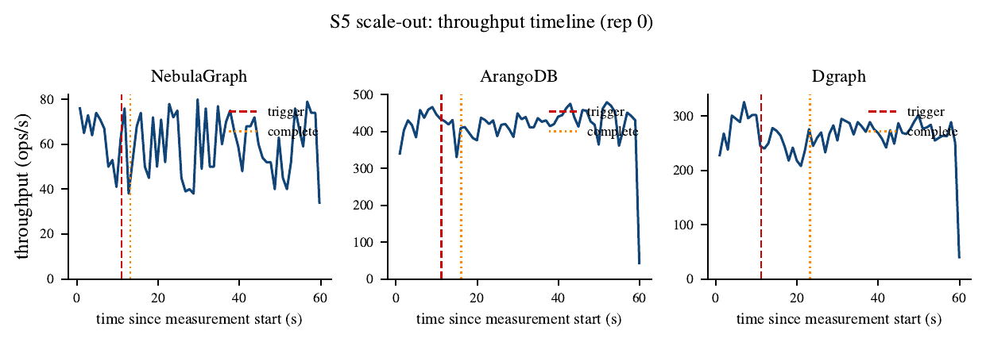
Result 4: Scale-Out Behavior (S5)
▸ New database node joins the cluster at t = 10 s — queries running throughout the 60 s window
▸ NebulaGraph: ~2 s · 50% dip · ArangoDB: 2–5 s · 91% dip · Dgraph: 1.9–12.1 s · 84% dip
▸ NebulaGraph fastest join despite being slowest overall — metadata-only registration, no immediate data rebalance
▸ No system recovered to ±5% of pre-event throughput within 60 s in most runs
Notes:
This is the most unique part of my study. In S5, I add a new server at t equals ten seconds while all three systems are serving queries. The chart shows throughput over time. The red line marks when the trigger fires, and the orange line marks when the new node is officially registered. NebulaGraph registers in about two seconds, and the throughput drops fifty percent. ArangoDB takes two to five seconds and drops ninety-one percent. Dgraph is the most interesting. Under two seconds in one run, over twelve in another. That is a huge range. For all three systems, throughput had not come back to normal within sixty seconds in most of the runs. The join itself is fast, but moving the data to the new node takes much longer.

Slide 12
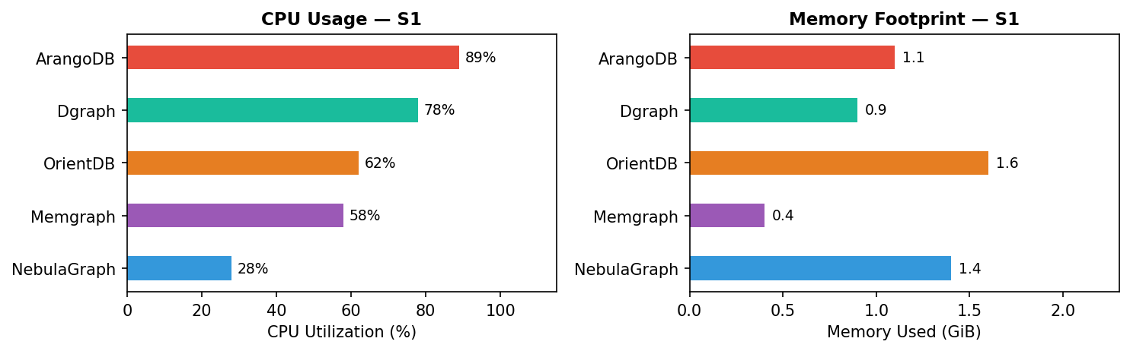
Result 5: Resource Utilization
▸ All figures measured during S1; dataset fits in RAM → disk I/O negligible
▸ NebulaGraph: only ~28% CPU despite being slowest — bottleneck is inter-process overhead, not compute
▸ OrientDB: highest memory ~1.6 GiB (Java heap) Memgraph: lowest ~0.4 GiB (native in-memory)
Notes:
I measured CPU and memory for each system during S1. Disk activity is essentially zero because the dataset fits in RAM. For CPU, the ranking follows throughput pretty closely. ArangoDB and Dgraph are working hard, NebulaGraph is not. NebulaGraph is actually the interesting case here. It uses only twenty-eight percent CPU despite being the slowest system. It is not slow because it is doing too much work. It is slow because of the communication overhead between its three internal processes, which are graphd, storaged, and metad. The bottleneck is architecture, not raw compute. For memory, Memgraph is the most efficient at zero point four gigabytes. It stores graph data very compactly. OrientDB is the heaviest at one point six gigabytes, mostly because of the Java runtime overhead.

Slide 13
Conclusion
▸ Open, reproducible protocol: 5 systems · 3 datasets · 5 scenarios · 444,297 requests
▸ Full code, data, and results: github.com/canetizen/pdgraph-bench
▸ ArangoDB fastest in all 5 scenarios
▸ NebulaGraph slowest overall — but joins scale-out fastest with the smallest throughput dip
▸ Dgraph shows real interference (+9%) under mixed workloads; ArangoDB benefits (−10%)
▸ Scale-out is the biggest differentiator — no system recovered within 60 s in most runs
▸ Limitations: tiny scale factor (SF = 0.003), 3 repetitions, single cluster size
▸ Future work: larger SF, longer S5 window, LDBC-curated parameter sets
Notes:
Let me wrap up. Over fifty-one runs on Google Cloud, recording nearly four hundred forty-four thousand requests, a few clear patterns emerged. ArangoDB consistently achieved the highest throughput across all five scenarios, while NebulaGraph was observed to be the slowest in terms of raw throughput. Interestingly though, NebulaGraph handled the scale-out with the smallest disruption and the fastest registration time. For mixed workloads, Dgraph showed a measurable interference effect, meaning its performance dropped when short reads and complex reads ran at the same time. And across all three Tier-1 systems, throughput was found not to recover to pre-event levels within sixty seconds after the scale-out in most runs. The main limitation of this study is the dataset size. I used the minimum scale factor the generators accept, so the results may look different at larger scales. Going forward, I would like to test with larger datasets, a longer scale-out window, and official LDBC parameter sets. The full code and results are on GitHub at github dot com slash canetizen slash pdgraph-bench. Thank you for listening, and I am happy to take any questions.

